Slide 1
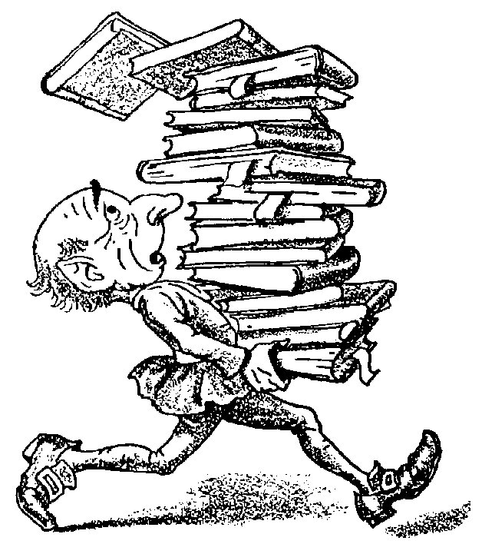
Before, During and After Reading and Comprehension Strategies
Becoming an Expert Reader

Slide 2
From our “Placemat Activity”…
We learned why, when/where, what, and how we read.
Today, we are going to focus on HOW we read with the Before, During and After reading strategy.

Slide 3
What does this strategy involve?
This strategy involves 3 easy steps:
Before reading
During reading
After reading

Slide 4
Why is this strategy important?
The Before, During and After reading strategy helps us comprehend what we read.
Create an understanding

Slide 5
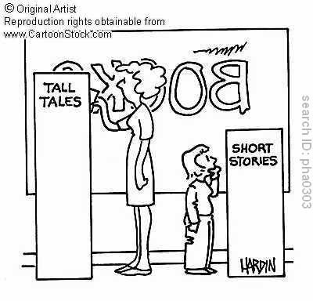
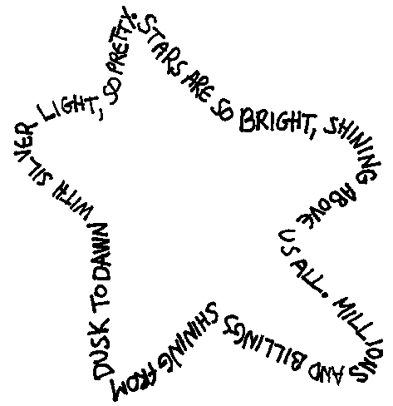
When do we use this strategy?
The Before, During and After reading strategy can be used ANYTIME you read a text.
Texts can be defined as any piece of reading material. A text can be a book, a comic, a website, or even a road sign.
We will be specifically studying the following texts: short stories, poems, and newspapers.

Slide 6
Before Reading
Goal: Readiness to explore a text

Slide 7
Before Reading (5 key points)
1. Decide on your purpose for reading
Why am I reading this text?

Slide 8
Before Reading (5 key points)
2. Preview the text
Think movie preview
What does this text appear to be about?
How is the text organized?

Slide 9
Before Reading (5 key points)
3. Activate prior knowledge
What do I already know, or think I know about this topic?
Think about any personal connections you may have with the text

Slide 10
Before Reading (5 key points)
4. Make a prediction
What do I think this text is going to be about?
Who is going to be in the text?
Where is this text taking place?
When is this taking place?

Slide 11
Before Reading (5 key points)
5. Make a plan for how to read the text
Think back to your PURPOSE: Why are you reading this text?
Should I scan? Scanning is a technique you often use when looking up a word in the telephone book or dictionary. You search for key words or ideas. In most cases, you know what you're looking for, so you're concentrating on finding a particular answer.
Should I skim? Skimming is used to quickly identify the main ideas of a text. When you read the newspaper, you're probably not reading it word-by-word, instead you're scanning the text.
Should I slowly read from the beginning to the end?

Slide 12
Before Reading (5 key points)
Review:
Purpose
Preview
Prior knowledge
Prediction
Plan

Slide 13
During Reading
Goal: Understanding (Create meaning)

Slide 14
During Reading (3 steps)
Summarize the text
Stop and restate the main ideas/points in your own words
Create a visual organizer (web, mind map, etc.)

Slide 15
During Reading (3 steps)
Check your understanding
Ask yourself the following questions:
Is what I just read clear to me? Do I get it?
What about if the text is still fuzzy or unclear?
Can I answer who, what, where, when and why questions about the text?

Slide 16
During Reading (3 steps)
Fix-up strategies
Reread part or all of the text
Use a dictionary
Skip the word and continue reading to see if the meaning becomes clears. If not, go back and re-read the paragraph, or choose another strategy.
Use the words in the rest of the sentence to predict a word that would make sense in the sentence
Sounding out the letters in the word to see if the word is a recognizable word
Look for root words, prefixes, suffixes, or endings that are known in the word
Examine other resources on this topic (example: books, the internet, videotapes)
Ask for help from a classmate or teacher
Make pictures in your mind to “see” what the text means

Slide 17
During Reading (3 steps)
Review:
Summarize
Check for understanding
Fix-up strategies

Slide 18
After Reading
Goal: Retention (Process ideas, and apply knowledge)

Slide 19
After Reading
Reflect, reflect, reflect!
Go back into the text
Show what you have learned with a final project

Slide 20
To Summarize:
What are the 3 steps to the reading strategy that we will be using?
_________
_________
_________
Before
1.
2.
3.
During
After

Slide 21
To Summarize:
BEFORE reading, what do we do?
1.
2.
3.
4.
5.
Purpose
Preview
Prior knowledge
Plan
Prediction

Slide 22
To Summarize:
DURING reading, what do we do?
1.
2.
3.
Summarize
Check understanding
Fix-up strategies

Slide 23
To Summarize:
AFTER reading, we:
1.
2.
REFLECT on what we have learned
Final project to show what we have learned

